Slide 1
Introduction To Machine Learning
Saravana

Slide 2
What is Machine Learning
Machine learning is an application of artificial intelligence (AI) that provides systems the ability to automatically learn and improve from experience without being explicitly programmed
Construct/Use Algorithm that learns from Data
More Information, Better Performance

Slide 3
Example of Machine Learning
Shape Colour
Rectangle Orange
Diamond Red
Square Green
Circle Orange

Slide 4
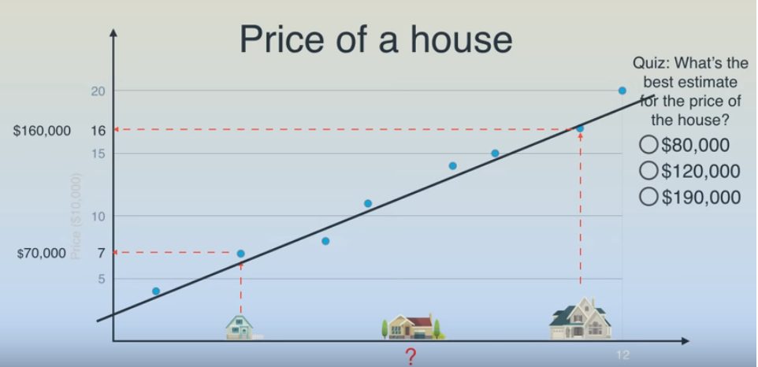
Machine Learning Example

Slide 5
Types of Machine Learning
Supervised Learning - algorithm consist of a target / outcome variable
Classification
Regression
Clustering
Unsupervised Learning - we do not have any target or outcome variable
Clustering
Anomaly detection
Reinforcement Learning - the machine is trained to make specific decisions
Positive & Negative

Slide 6
Applications of Machine Learning
Image Recognition
Speech Recognition
Medical Diagnosis
Statistical Arbitrage
Regression
Classification
Recommendation System
Spam Detection and a lot more

Slide 7
Steps in Machine Learning
Data collection
Exploratory Data Analysis
Formatting data to make it consistent & Ready for modeling
Feature Extraction/Feature Selection
Splitting data into training and evaluation sets
Learning
Evaluation

Slide 8
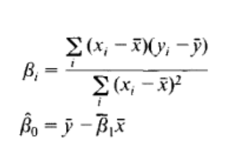
First ML Algorithm
Linear Regression is a machine learning algorithm based on supervised learning. It performs a regression task
Y = aX+b
Where y is the dependent variable, a is the scale factor or coefficient, b being the bias coefficient and X being the independent variable.
Ordinary Least Mean Square
where x¯ is the mean of the input variable X and y¯ being the mean of the output variable Y.

Slide 9
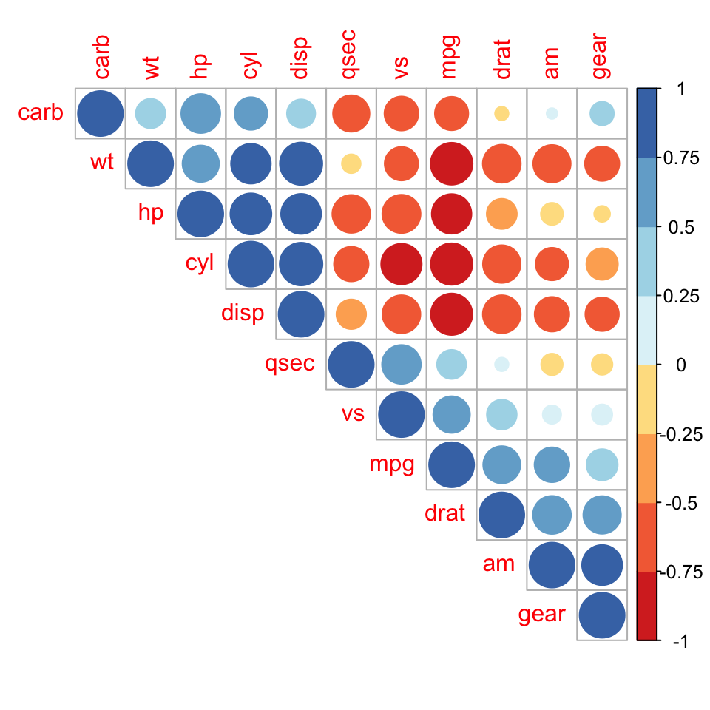
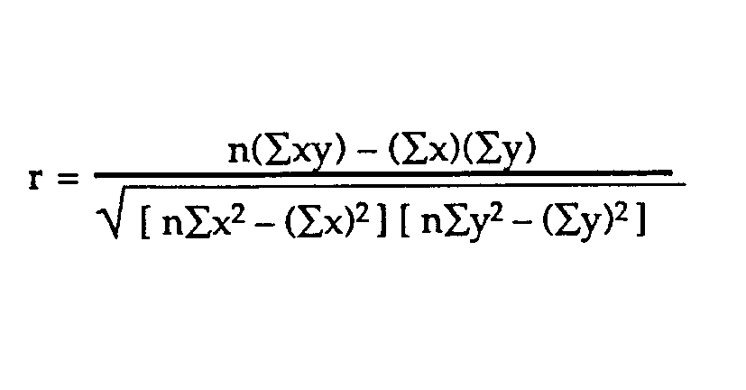
R – Correlation Coefficient

Slide 10
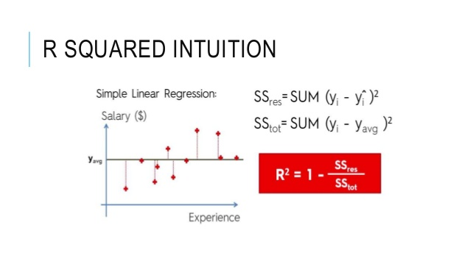
R2 – Coefficient of Determination

Slide 11
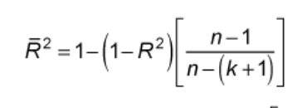
Adjusted R2 – Adjusted Coefficient of Determination
One major difference between R-squared and the adjusted R-squared is that R-squared supposes that every independent variable in the model explains the variation in the dependent variable.
R-squared cannot verify whether the coefficient ballpark figure and its predictions are prejudiced.
The adjusted R-squared is a modified version of R-squared for the number of predictors in a model.

Slide 12
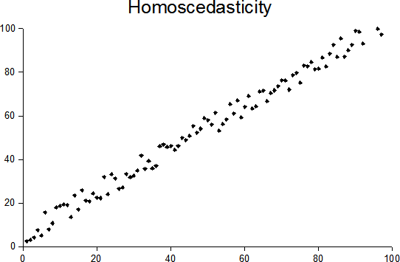
Assumptions
Linear relationship
Multivariate normality
No or little multicollinearity
No auto-correlation
Homoscedasticity

Slide 13
Thanks

